Slide 1
The React Context API
Lesson 20.2
Notes:
We will learn React Context, a built-in state management alternative to library like Redux

Slide 2
Learning Objectives
React Context
Loosely vs Tightly Coupled Components
State Management Techniques
Provider / Consumer Pattern

Slide 3
Giving Context
Notes:
State management has been a problem with react for a long time
Redux came out in 2015 to help with this and quickly became the most popular state management library
About a year and a half ago React Context was released in stable (out of experimental) as a built-in light-weight tool for state management
I’ve had quite a few engineers who didn’t know about this and were really excited when I taught it to them

Slide 4
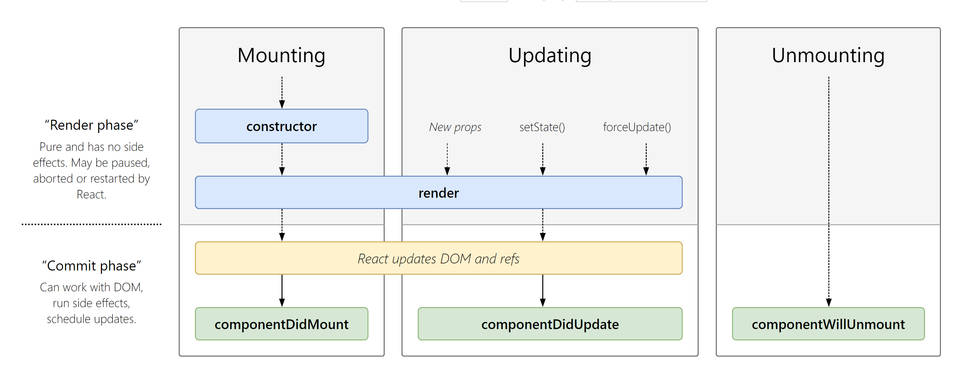
React Component Lifecycle (v 16.4)
Notes:
Before we get into React context, here’s a refresher on the react lifecycle
http://projects.wojtekmaj.pl/react-lifecycle-methods-diagram/
The 3 main phases of the component lifecycle are mounting, updating, and unmounting.
Point out that the 2 primary ways of causing a component to re-render are passing it _new_ props or by using the `setState()` method.

Slide 5

Prop Drilling
Page Component
Prop drilling is the process you go through to get data to parts of the React component tree.
Although it seems tedious, prop drilling is often necessary to avoid complicating the global state of your application
Remember, it’s often best to keep our state as close as possible to
where it’s relevant.
Why can’t we just add state to the lowest level component?
Image
Gallery Component
Image
Card Component
Image
Image Component
Image
Notes:
Prop drilling is the process that you have to go through to get data to parts of the React Component tree.
Remind the students that it's often best to keep the state as close to where it's relevant as possible.
We can't simply add state to the lowest level component because that would defeat the purpose of using presentational components.
Use this question as a segway into the next slide.

Slide 6



Container vs. Presentational Components
Separate the logic from the looks
Container components include the logic of the application, which is often stored in the component's state, requiring us to use class components instead of functional components.
Presentational components are primarily used for UI elements like layout, and often use stateless functional components (often referred to as “dumb components”) to render their content.
Not all presentational components have to be stateless. Some may contain UI elements in their state.
Notes:
shutterstock_260250098

Slide 7
Context API
The Context API allows you to pass data through the component tree without having to pass down props through many component levels.
The Context API consists of two key parts:
01
Provider
02
Consumer
The provider wraps our presentational component and stores data in its state.
The consumer goes inside the presentational component and allows us to grab values from the provider.
Notes:
Oftentimes, applications need an easier way to manage state than passing `props` down several component levels.
To avoid adding in unnecessary state, we can use a feature called the React Context API.
The React Context API provides a solution to this problem without introducing the complexity of an entire state management library.

Slide 8

The technique of passing data directly into a component is known as dependency injection.

Slide 9
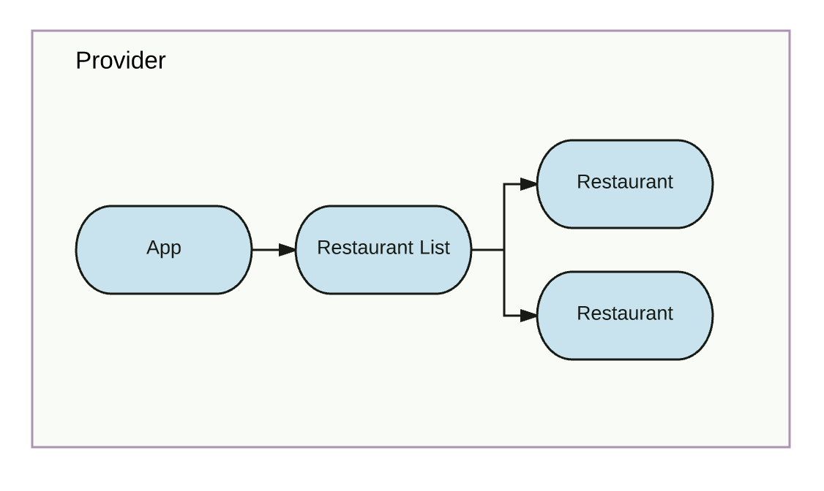
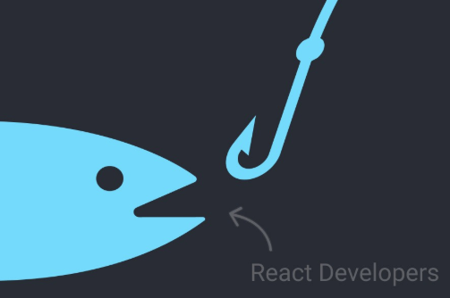
Providers & Consumers
Provider
Consumer
A context consumer is used to access properties of a Context object.
All consumers must be descendants of their respective providers.
A context provider is used to wrap a component that has a child component that will need access to the Context object.
Because we’ll be using hooks, our hook will use the consumer behind the scenes.
Notes:
Explain that a Context `Provider` is used to wrap a component that has a child component that will need access to the Context Object.
Explain that a Context `Consumer` is used to access properties of a Context Object.
All `Consumer`s must be descendants of their respective `Provider`s.
https://medium.com/@laurenhp95/connecting-redux-with-react-context-72a8f44aba21

Slide 10

Tightly Coupled vs. Loosely Coupled
Using the Context API can be very helpful, but it comes at a cost. Adding stateful logic to a component creates a dependent relationship to another component. This is known as coupling.
When writing applications, it is best to keep components loosely coupled so that you can change one without affecting the other. This also helps ensure reusability.
Component
1
Component
2
Component
3
Component
4
Component
1
Component
2
Component
3
Component
4
Context API 1
Context API 2
Context API 3
Context API 4
State
Increasing complexity over time reduces scalability, reliability, portability and security.
Platform approach provides standardization, consolidation, normalization and governance.

Slide 11
Loosely Coupled Components
Using the Context API can be very helpful, but it comes at a cost. Adding stateful logic to a component creates a dependent relationship to another component. This is known as coupling.
Tight Coupling
Loose Coupling
More Interdependency, coordination and information flow
When writing applications, it is best to keep components loosely coupled so that you can change one without affecting the other. This also helps ensure reusability.

Slide 12
Loosely Coupled Components
Tightly coupled components should be avoided when possible.
Coupling increases the dependencies necessary for a component. This means that one single change could have unintended consequences throughout the application. This also makes it harder to test and debug individual pieces.
Coupling reduces the overall reusability of components.

Slide 13
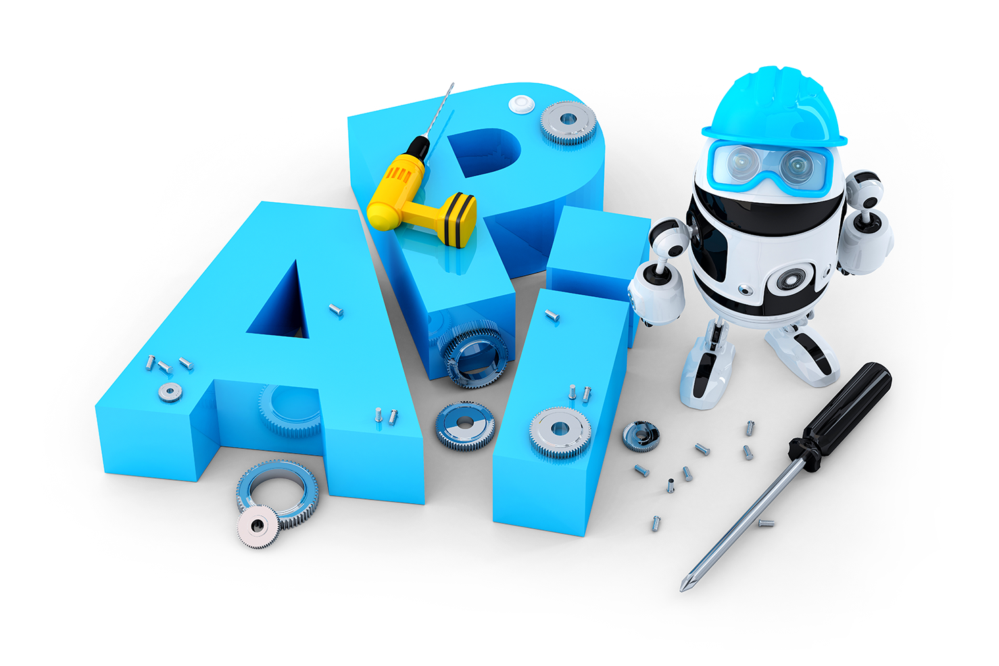
State Management
Try to be mindful of how often you’re using the Context API.
If you find yourself using the Context API throughout several components, it may be time to consider using Redux or another state management library.

Slide 14
REMEMBER: There’s no perfect way to structure your application. It isn’t uncommon to be far along into development before you realize that you need to use the Context API. This is completely normal!

